Slide 1
CSCI 6521 Advanced Machine Learning, I Chapter 04: Applications of Variational Autoencoders
Md Tamjidul Hoque

Slide 2
Autoencoders
Autoencoders is a neural network made up of two parts:
An encoder network compresses high-dimensional input data into a lower dimensional representation vector.
A decoder network decompresses a given representation vector back to the original domain.
This process is shown in Figure 1.
Figure 1: Diagram of an autoencoder.
Notes:
Reference: Generative Deep Learning: Teaching Machines to Paint, Write, Compose, and Play, by David Foster.

Slide 3
… Autoencoders
The network (Figure 1) is trained to find weights for the encoder and decoder that minimize the loss between the original input and
the reconstruction of the input after it has passed through the encoder and decoder.
The representation vector is a compression of the original image into a lower dimensional, latent space.
The idea is that by choosing any point in the latent space, we should be able to generate novel images by passing this point through the decoder,
since the decoder has learned how to convert points in the latent space into viable images.

Slide 4
… Autoencoders
Autoencoders can also be used to clean noisy images, since the encoder learns that it is not useful to capture the position of the random noise inside the latent space.
For tasks such as this, a 2D latent space is probably too small to encode sufficient relevant information from the input.
However, as we shall see, increasing the dimensionality of the latent space quickly leads to problems if we want to use the autoencoder as a generative model.
Let us now build an autoencoder in Keras:
See exercise: #1_autoencoder_train.ipynb
Analysis of the Autoencoder:
See exercise: #2_autoencoder_analysis.ipynb

Slide 5
Building a Variational Autoencoder
Let us now try to understand mathematically what we need to do to our autoencoder to convert it into a variational autoencoder and thus make it a truly generative model.
There are actually only two parts that we need to change:
the encoder and
the loss function.

Slide 6
… Building a Variational Autoencoder: Encoder
The Encoder
In an autoencoder, each image is mapped directly to one point in the latent space.
In a variational autoencoder, each image is instead mapped to a multivariate normal distribution around a point in the latent space, as shown in Figure 11.
Figure 11: The difference between the encoder in an autoencoder and a variational autoencoder.

Slide 7
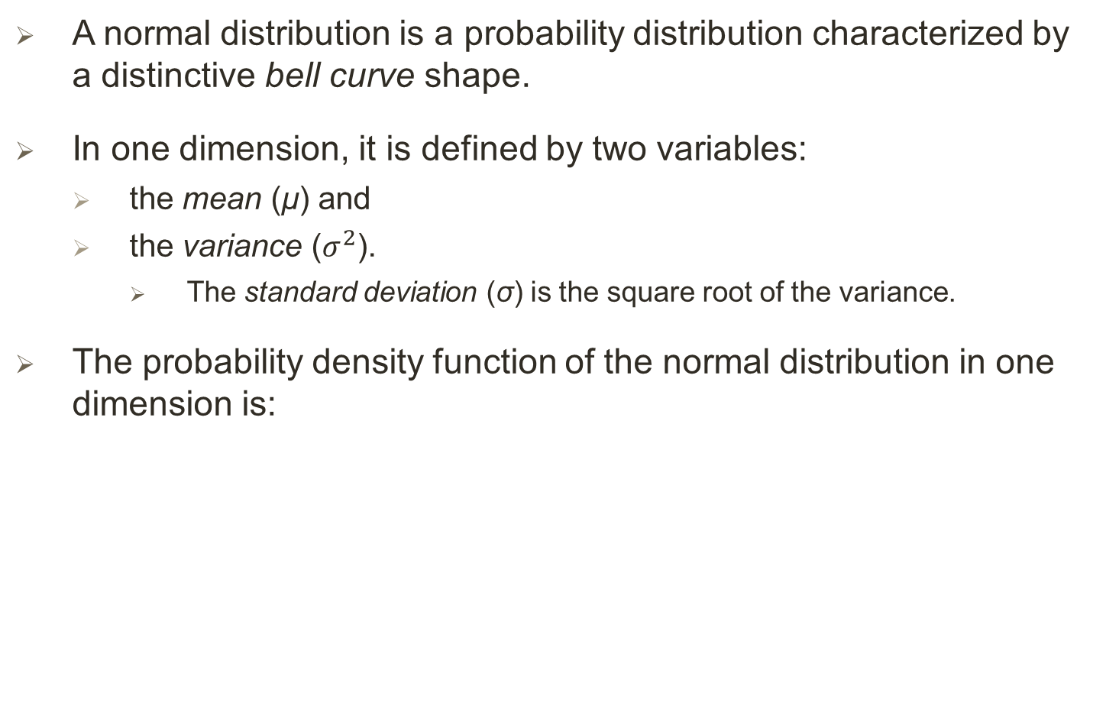
The Normal Distribution
A normal distribution is a probability distribution characterized by a distinctive bell curve shape.
In one dimension, it is defined by two variables:
the mean (μ) and
the variance ($σ^{2}$).
The standard deviation (σ) is the square root of the variance.
The probability density function of the normal distribution in one dimension is:

Slide 8
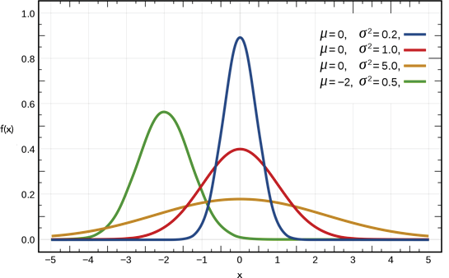
… The Normal Distribution
Figure 12 shows several normal distributions in one dimension, for different values of the mean and variance.
The red curve is the standard normal—the normal distribution with mean equal to 0 and variance equal to 1.
Figure 12: The normal distribution in one dimension.

Slide 9
… The Normal Distribution
We can sample a point z from a normal distribution with mean μ and standard deviation σ using the following equation:
z = μ + σ ε,
where ε is sampled from a standard normal distribution
The concept of a normal distribution extends to more than one dimension—the probability density function for a general multivariate normal distribution in k dimensions is as follows:
In 2D, the mean vector μ and the symmetric covariance matrix Σ are defined as:
where ρ is the correlation between the two dimensions x₁ and x₂.

Slide 10
… Building a Variational Autoencoder: Encoder
Variational autoencoders assume that there is no correlation between any of the dimensions in the latent space and therefore that the covariance matrix is diagonal.
This means the encoder only needs to map each input to a mean vector and a variance vector and does not need to worry about covariance between dimensions.
We also choose to map to the logarithm of the variance, as this can take any real number in the range (– ∞, ∞), matching the natural output range from a neural network unit, whereas variance values are always positive.
To summarize, the encoder will take each input image and encode it to two vectors, mu and log_var which together define a multivariate normal distribution in the latent space:
mu, which is the mean point of the distribution.
log_var, which is the logarithm of the variance of each dimension.

Slide 11
… Building a Variational Autoencoder: Encoder
To encode an image into a specific point z in the latent space, we can sample from this distribution, using the following equation:
z = mu + sigma * epsilon
where†, sigma = exp (log_var / 2) and epsilon is a point sampled from the standard normal distribution.
So why does this small change to the encoder help?
Previously, we saw how there was no requirement for the latent space to be continuous—even if the point (–2, 2) decodes to a well-formed image of a 4, there was no requirement for (–2.1, 2.1) to look similar.
Now, since we are sampling a random point from an area around mu, the decoder must ensure that all points in the same neighborhood produce very similar images when decoded, so that the reconstruction loss remains small.
This is a very nice property that ensures that even when we choose a point in the latent space that has never been seen by the decoder, it is likely to decode to an image that is well formed.
Let us now build the variational autoencoder’s encoder in Keras:
See exercise: #3_ vae_digits_train.ipynb
Notes:
† σ = exp (log (σ)) = exp (2 log (σ) /2) = exp log ((σ²) /2)

Slide 12
… Building a Variational Autoencoder: Loss Function
Previously, our loss function only consisted of the RMSE loss between images and their reconstruction after being passed through the encoder and decoder.
This reconstruction loss also appears in a variational autoencoder, but we require one extra component: the Kullback–Leibler (KL) divergence.
KL divergence is a way of measuring how much one probability distribution differs from another.
In a VAE, we want to measure how different our normal distribution with parameters mu and log_var is from the standard normal distribution.
In this special case, the KL divergence has the closed form:
kl_loss = -0.5 * sum(1 + log_var - mu ^ 2 - exp(log_var))
or in mathematical notation:

Slide 13
… Building a Variational Autoencoder: Loss Function
The sum is taken over all the dimensions in the latent space.
kl_loss is minimized to 0 when mu = 0 and log_var = 0 for all dimensions.
As these two terms start to differ from 0, kl_loss increases.
In summary, the KL divergence term penalizes the network for encoding observations to mu and log_var variables that differ significantly from the parameters of a standard normal distribution, namely mu = 0 and log_var = 0.
Why does this addition to the loss function help?
First, we now have a well-defined distribution that we can use for choosing points in the latent space—the standard normal distribution.
If we sample from this distribution, we know that we’re very likely to get a point that lies within the limits of what the VAE is used to seeing.
Secondly, since this term tries to force all encoded distributions toward the standard normal distribution, there is less chance that large gaps will form between point clusters.
Instead, the encoder will try to use the space around the origin symmetrically and efficiently

Slide 14
… Building a Variational Autoencoder: Loss Function
In the code, the loss function for a VAE is simply the addition of the reconstruction loss and the KL divergence loss term.
We weight the reconstruction loss with a term, r_loss_factor, that ensures that it is well balanced with the KL divergence loss.
If we weight the reconstruction loss too heavily, the KL loss will not have the desired regulatory effect and we will see the same problems that we experienced with the plain autoencoder.
If the weighting term is too small, the KL divergence loss will dominate and the reconstructed images will be poor.
This weighting term is one of the parameters to tune when we are training your VAE.
See exercise again: #3_ vae_digits_train.ipynb [see example 8]

Slide 15
… Building a Variational Autoencoder:
Analysis of the Variational Autoencoder:
See exercise: #4_vae_digits_analysis.ipynb.
Using VAEs to Generate Faces:
See exercise: #5_vae_faces_train.ipynb.
Analysis of the VAE for faces:
See exercise: #6_vae_faces_analysis.ipynb.
END.

